Slide 1

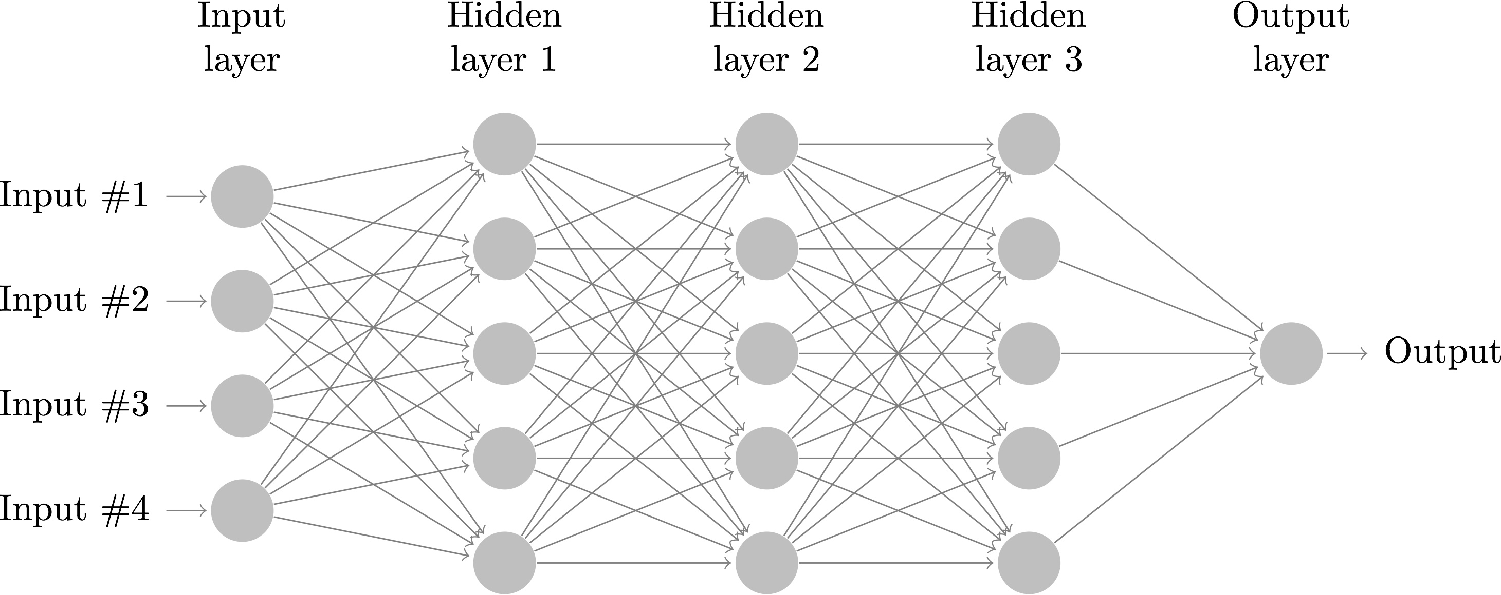
Classifying Hate Speech
An Exploration of Neural Net Hyperparameter Considerations
Allan Buchness, CS4701

Slide 2
YOUTUBE INTRO
https://youtu.be/65sUTDyaCWs

Slide 3
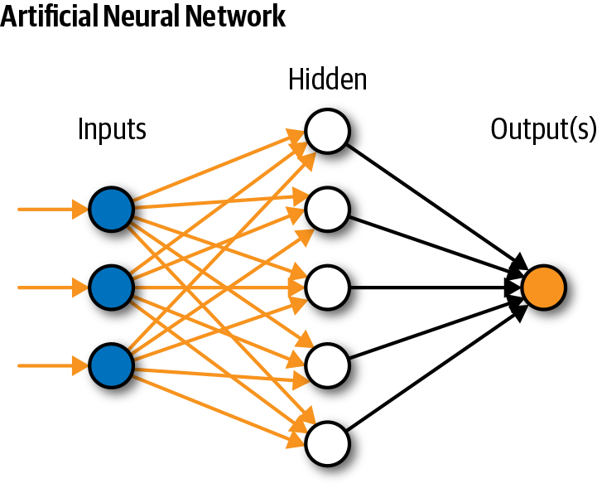
Why Neural Nets?
Deep Learning Limitations: Linear Methods
Natural Language Barriers
Modern Applications
Highly customizable and approachable
Cutting-Edge (New benchmarks surpassed yearly)

Slide 4


Data and Goal
Labeled Twitter Tweets
Binary Classification:
Objectionable Language
Not Objectionable Language
Implement and Adjust a Neural Net
Explore Neural Net Hyperparameter Options

Slide 5
Pre-Processing
Alpha Characters
Case Flattening
Stopword Removal
Stemming
Hashtag Removal
Tokenizing
Vectorizing

Slide 6
Basic Network Topography
Input: Batches of Strings.
67% as Training and Validation
33% as Test data
Neural Net:
Input Layer (symbolic)
Vectorizer Layer (non-training)
Embedding Layer (optional)
n Hidden Layers of size m
Output layer of size 1

Slide 7
Optimization Hyperparameters
Number of Hidden Layers
Neurons per hidden layer
Regularization and Bias
Learning Rate
Backpropagation Function
Dropout Rate
Weight Sharing
Batch Size
Vectorizer Output
Embedded Layer
Corpus Limit
Input Sequence Size
Training Iterations (Epochs)
Loss Function
Optimizer Function

Slide 8
Evaluation
Three Metrics to Demo:
Pre-Processing Parameters (
Presence of Embedded Layer
Number of Neurons per hidden layer
Number of Hidden Layers
Evaluation Criteria:
Runtime, Training Accuracy, Validation Accuracy

Slide 9
Discussion of Output
Pre-Processing Optimum:
Stemming=True
Stopwords=False
Hashtags=False
Embedding: Increases Accuracy, but also Runtime
n Dense Layers:
Increases Accuracy Better than Embedding for fewer trainable parameters
MANY MORE parameters to Optimize and combine

Slide 10
Optimization Process: Conclusion
Combination of hyperparameters:
Input parameters:
Pre-processing
Size and shape of data and batches
Vectorizer Parameters
Dataset Distribution (training, validation, testing)
Model Parameters:
Activation, Loss, Optimization
Overall topography
Adjustment Feedback Loop

Slide 11
Implementation Notes
64bit-Windows 10, 2.30 GHz Intel Core i5-6200U CPU, 8GB RAM
Python 3.8 – Keras atop TensorFlow –
NLTK for pre-processing:
Snowball Stemmer
TweetTokenizer
nltk.corpus Stopwords: English, Spanish, French

Slide 12
Further Extensions
Distributed Computing with Keras
Expanding Pre-Processing Suite
n-gram support
Punctuated Language (‘C*rn*ll’ = ‘Cornell’)
Neural Net Layers: CNN?
Automated Optimization
Multi-Classifier
Deployment

Slide 13

Project Take-aways
Neural Networks are complicated
Hard to implement and understand
Hyperparameter Optimization is Complex
Crucial for robust NLP
Efficient for Small Projects and Large Deployments
State of Neural Net Implementation Today

Slide 14
User Interface Notes
I have implemented Extensible Code that can be used to:
1. Pre-Process your own text with parameters:
Alphas Only, Stemming, Stopwords, Include Hashtags
2. Design your own Neural Net Models with parameters:
Training input, Maximum Corpus Tokens, Output Sequence Length, Number of hidden layers, Size of hidden layers, Activation functions (hidden and output), loss function, optimizer, and presence of Embedded Layer
3. Which can be run with:
Training Data, Validation Data, Batch Size, Number of Epochs, and debug and metrics information
4. And evaluation data can be viewed with an accuracy and loss plotter

Slide 15

Notes. and Questions?
See Project Write-Up for implementation notes, a user interface guide, and references. The project comes with training data, but you may use your own as well.
Project Demo?
Questions?

